Slide 1
Tone
In each the pictures, use your notes to help you find an adjective to describe the tone of each of these paintings.
What aspects of the painting help create that tone?

Slide 2
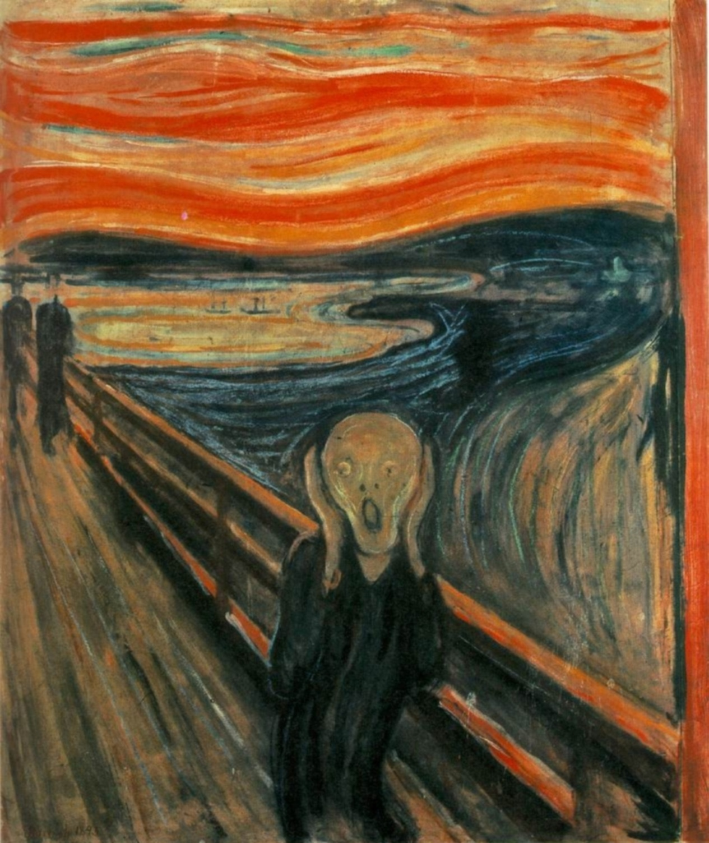

Slide 3
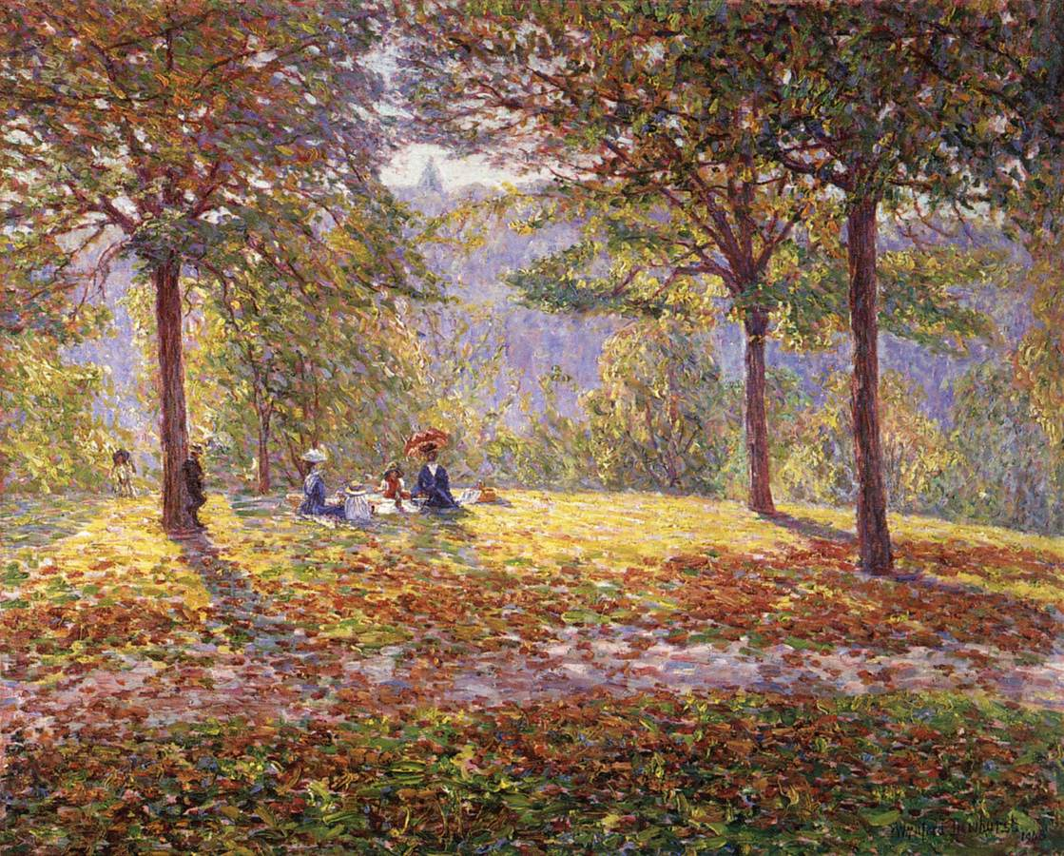

Slide 4
