Slide 1
Imagery
Todd and Brad Reed are a father and son photography team from Ludington, Michigan.
Choose one or more of these images for your poems. Remember, thing about what someone would see, smell, hear, taste, touch, and feel (although you might not use all the senses).

Slide 2
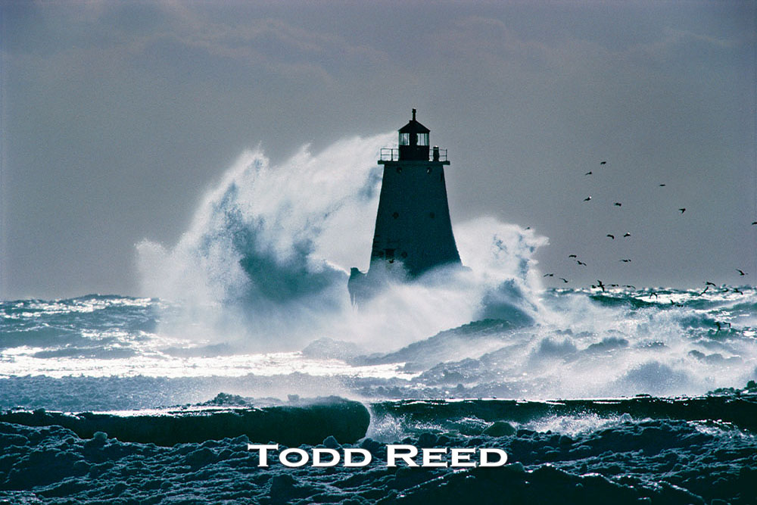

Slide 3
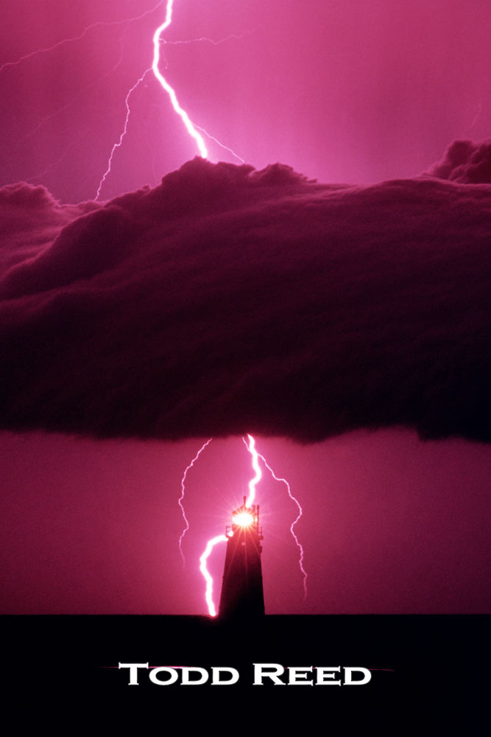

Slide 5
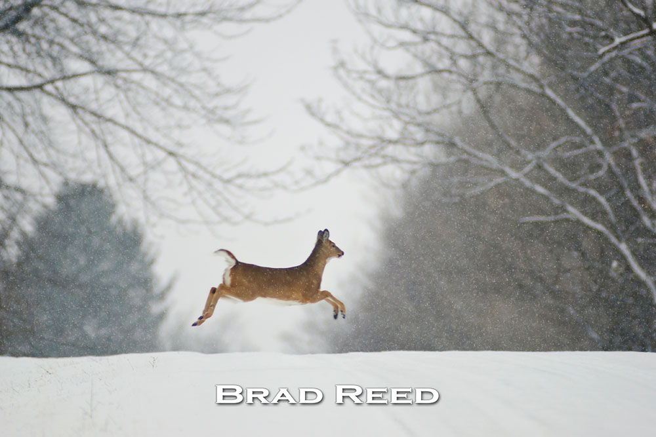

Slide 6
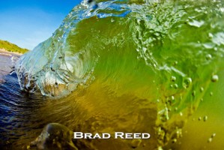

Slide 7
